Slide 1
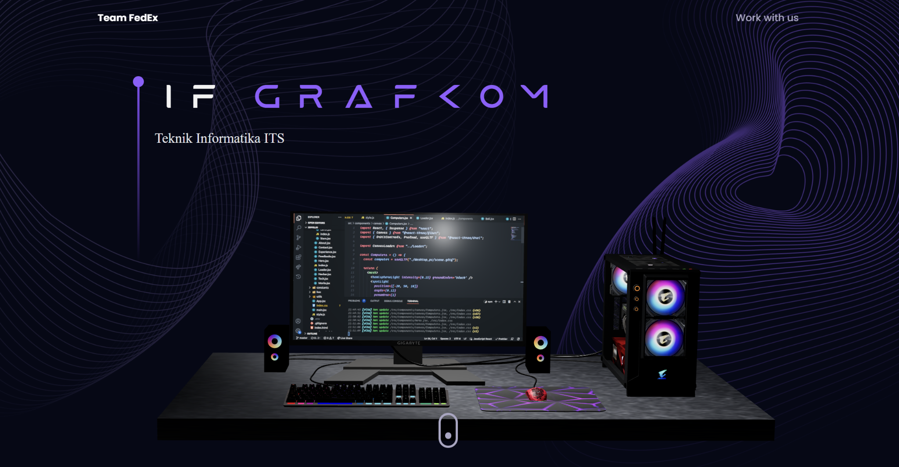
3D-SaaS Website
M. Fachry Dwi Handoko 5025201159 Faraihan Rafi Adityawarman 5025211074
Pascal Roger Junior Tauran 5025211072

Slide 2
Website Features
Intro page with 3D elements that rotate as you scroll down.
Home page with 3D elements that you can interact with.

Slide 3
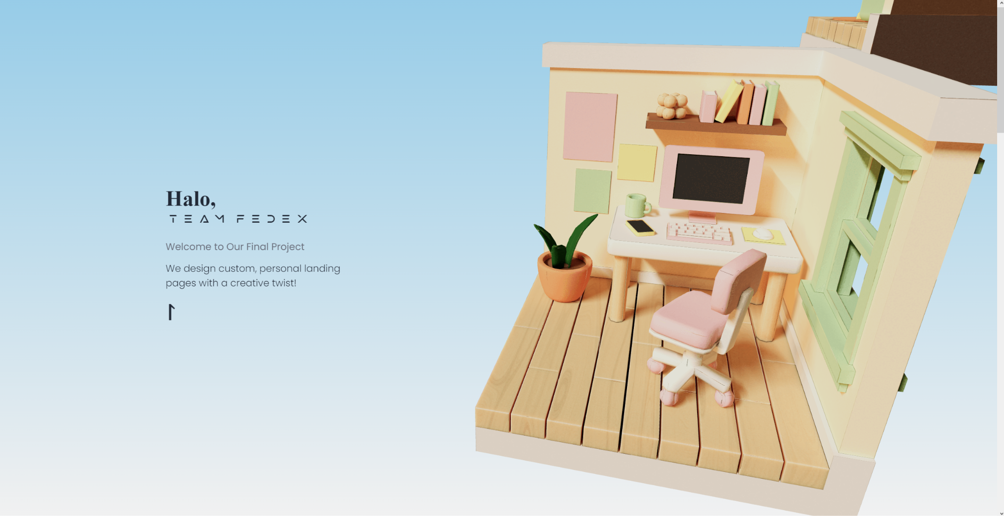
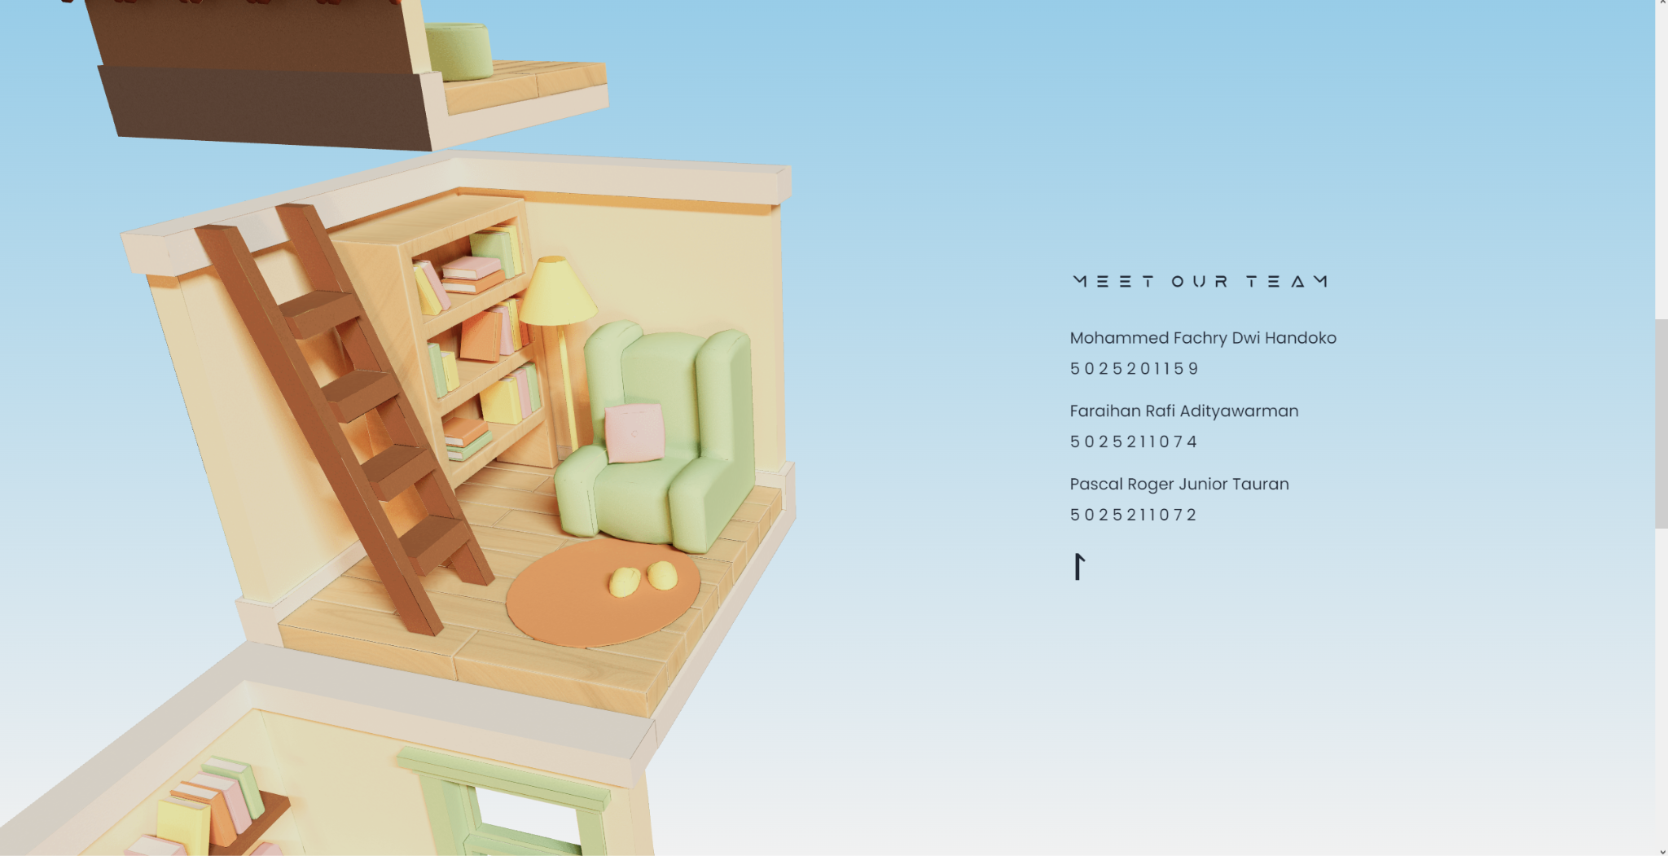
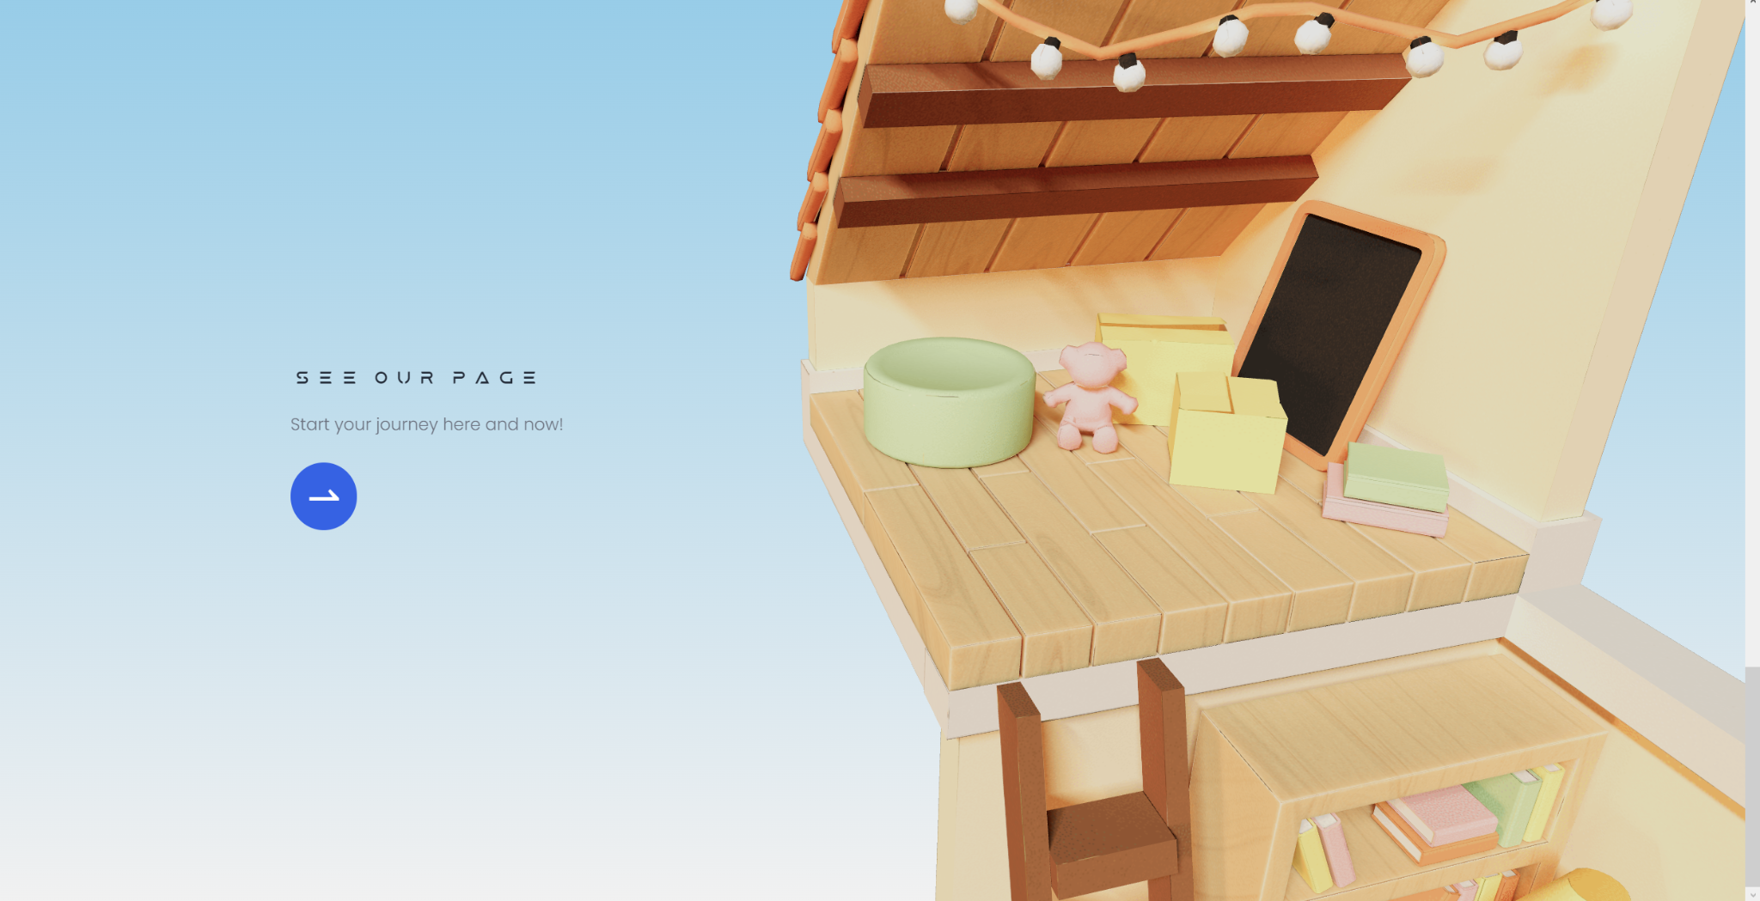
Intro Scene

Slide 4
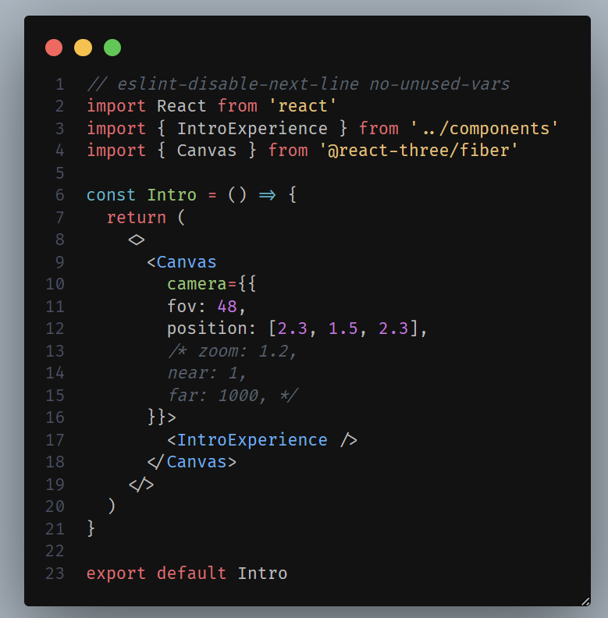
Intro.jsx
Camera is to set the position of the camera itself

Slide 5
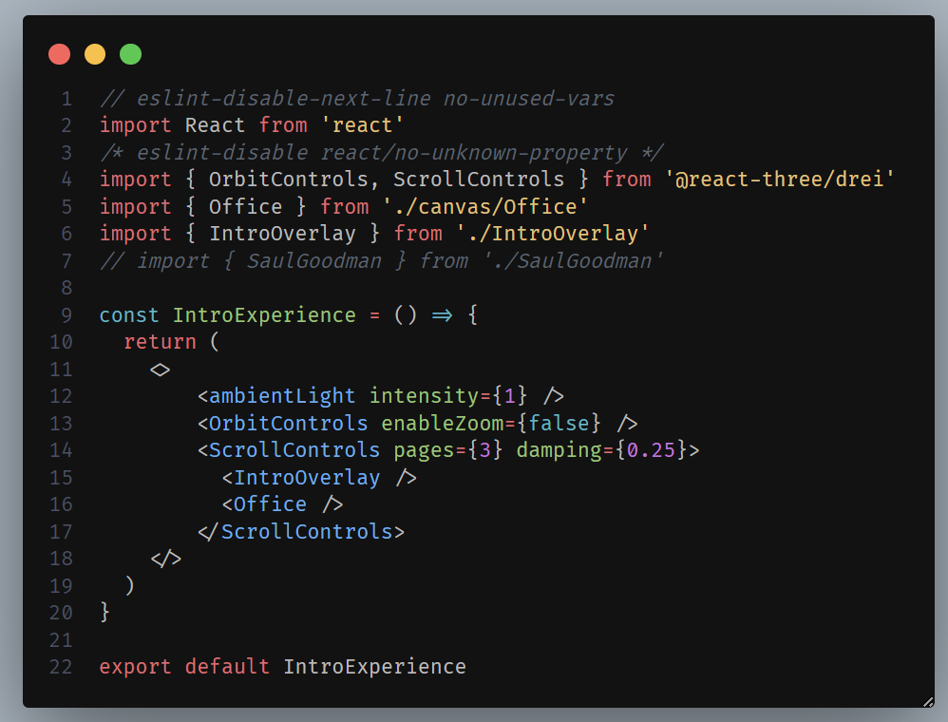
IntroExperience.jsx
To accompany the intro page itself we made the controls and lighting in this jsx file
“<Office />” is used to import the 3D model itself to the jsx file

Slide 6
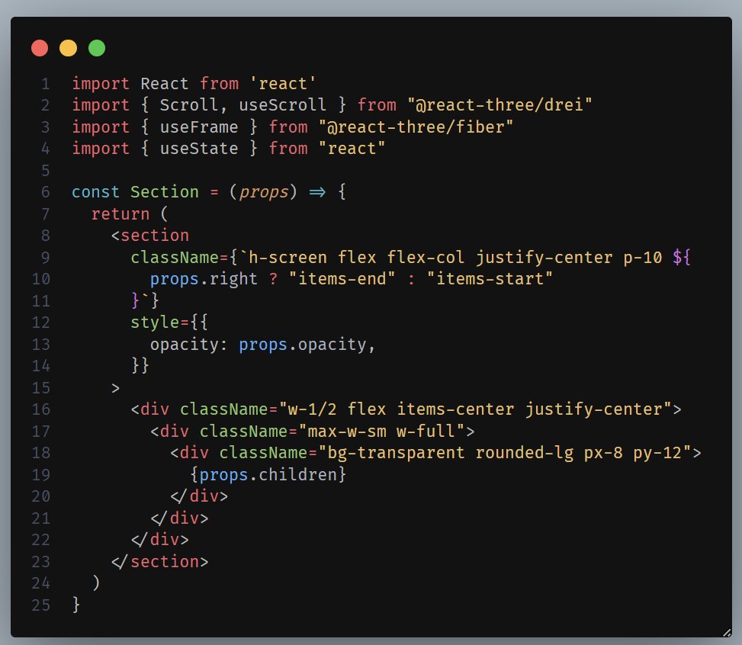
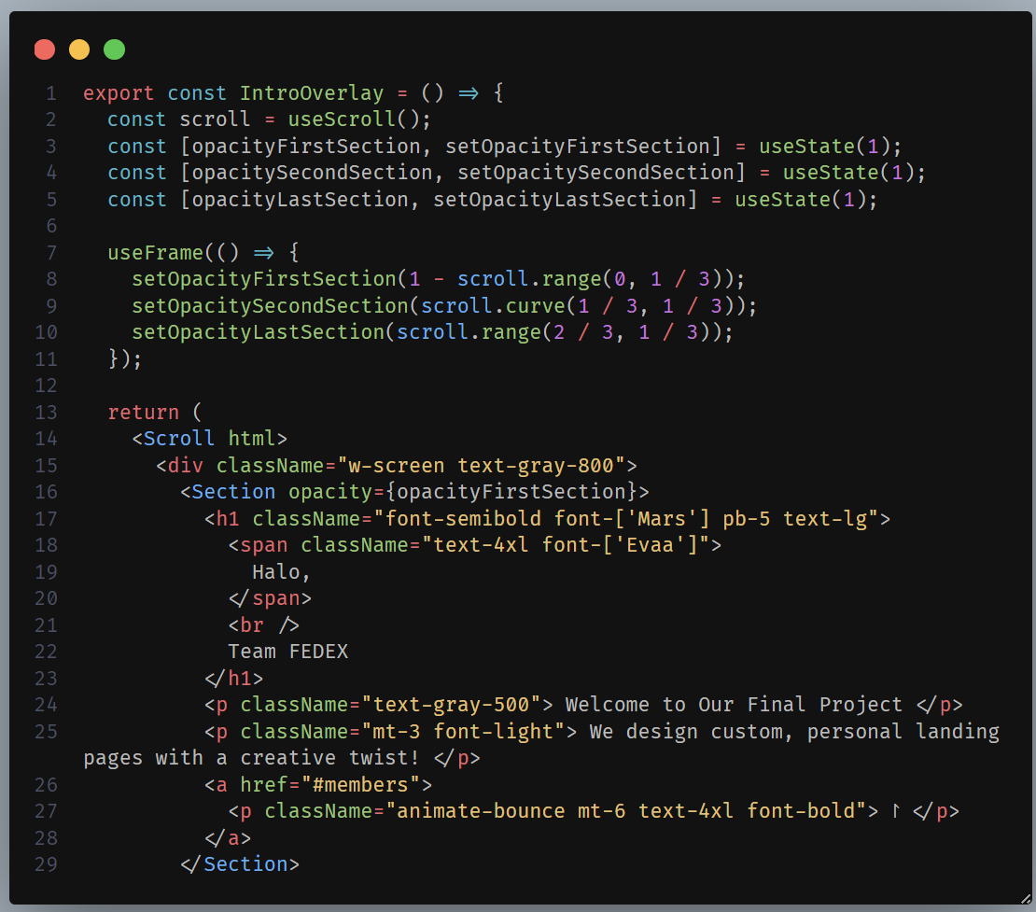
IntroOverlay.jsx
A section of IntroOverlay.jsx consisting of messages

Slide 7
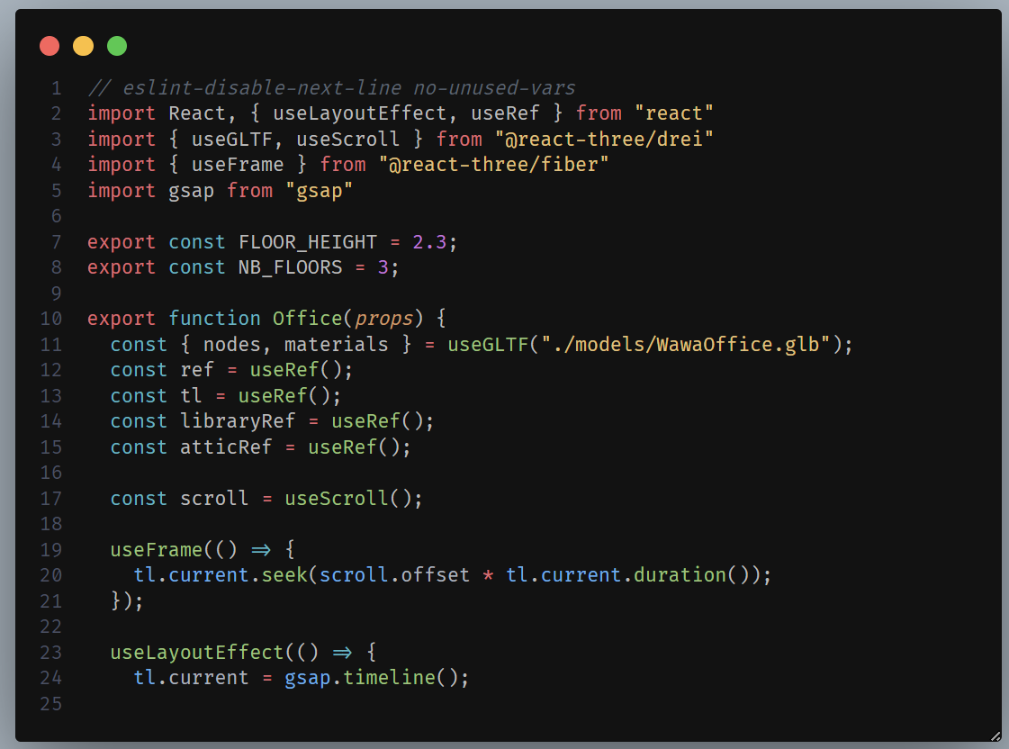
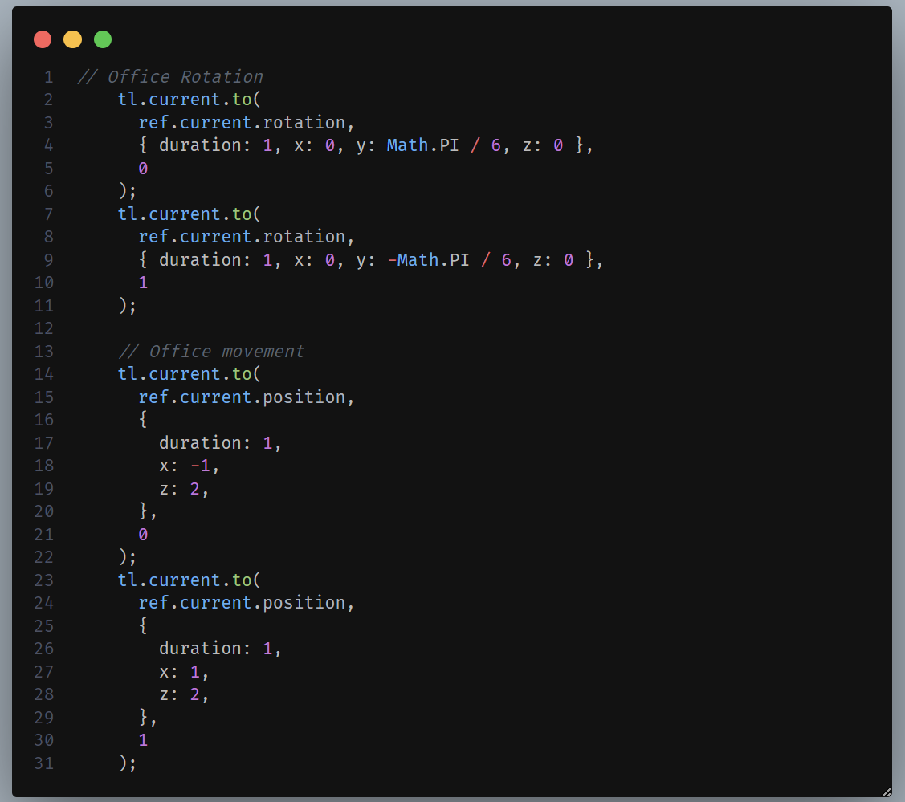
Office.jsx
We modify each movement of the office in the Office.jsx. That consist of the rotation, movement, etc (using GSAP)

Slide 8
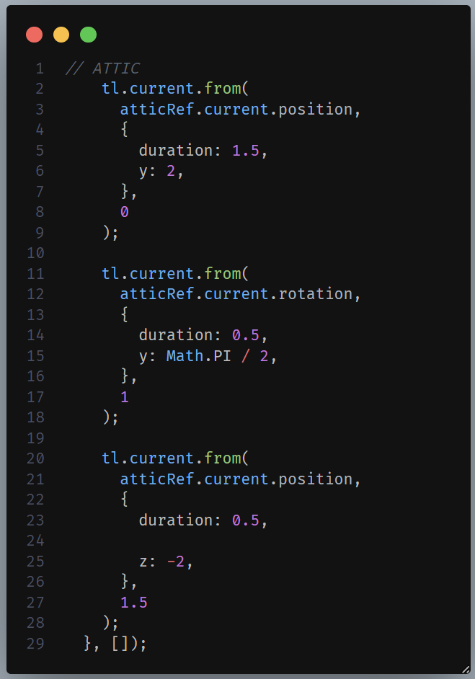
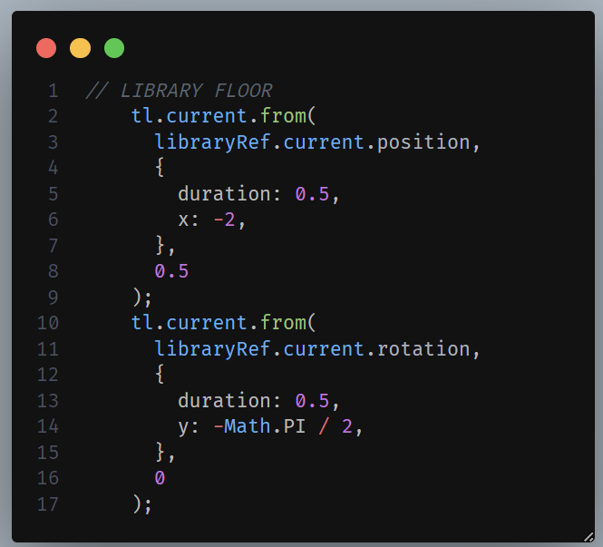
Library.jsx and Attic.jsx

Slide 9
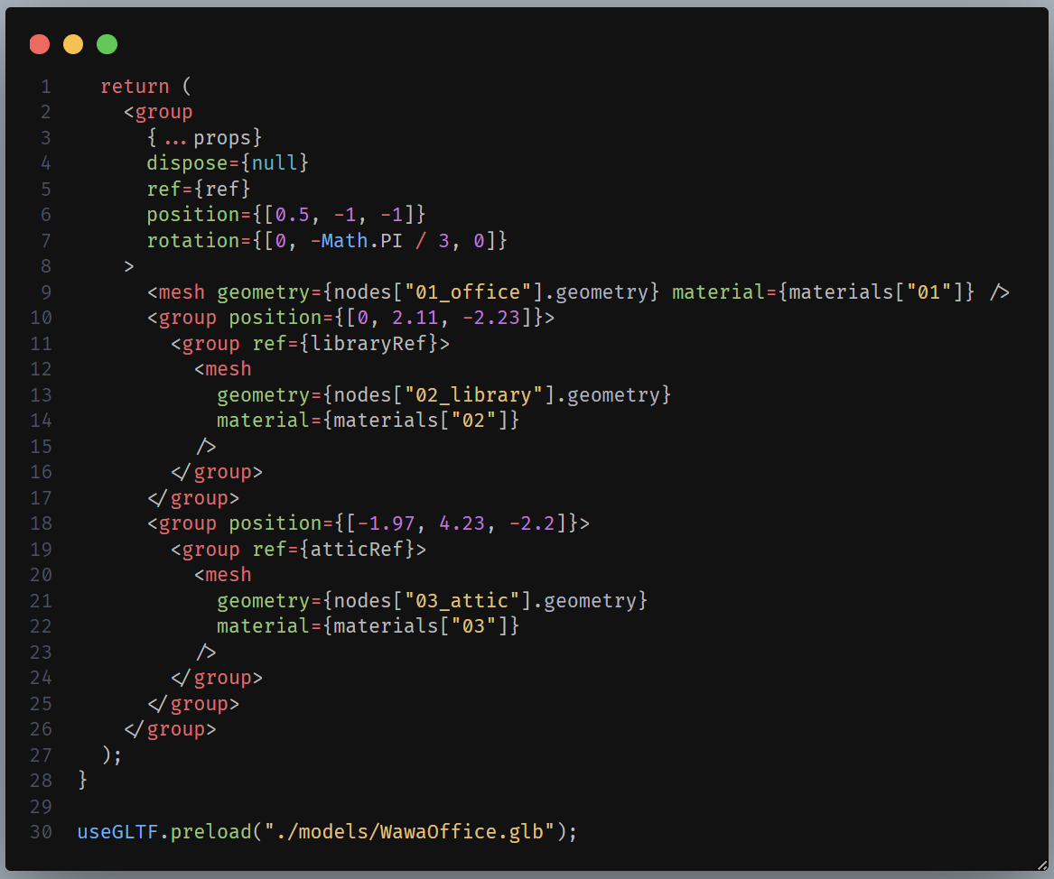
Position settings for each 3D models in Intro.jsx

Slide 10

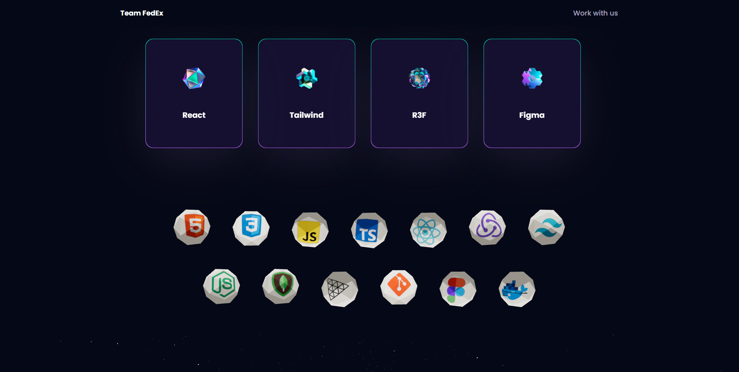
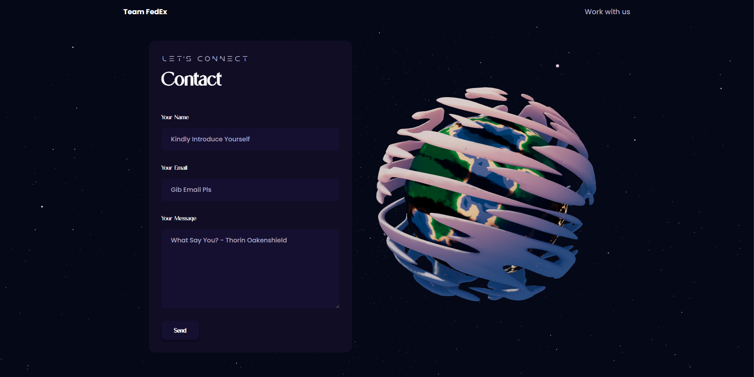
Home page Scene

Slide 11
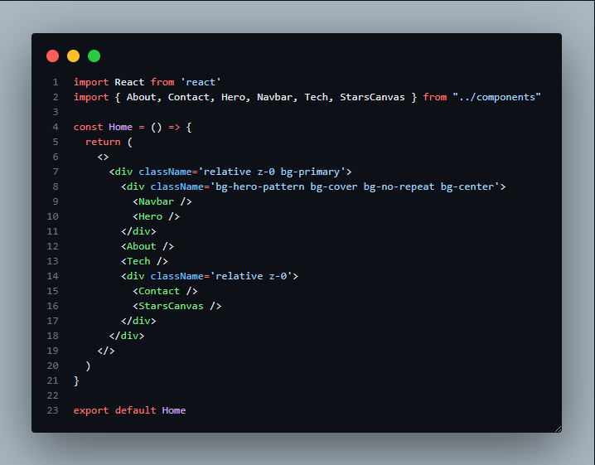
Home.jsx
This calls the `Navbar`, `Hero`, `About`, `Tech`, `Contact` and `StarsCanvas` elements for the web page.

Slide 12
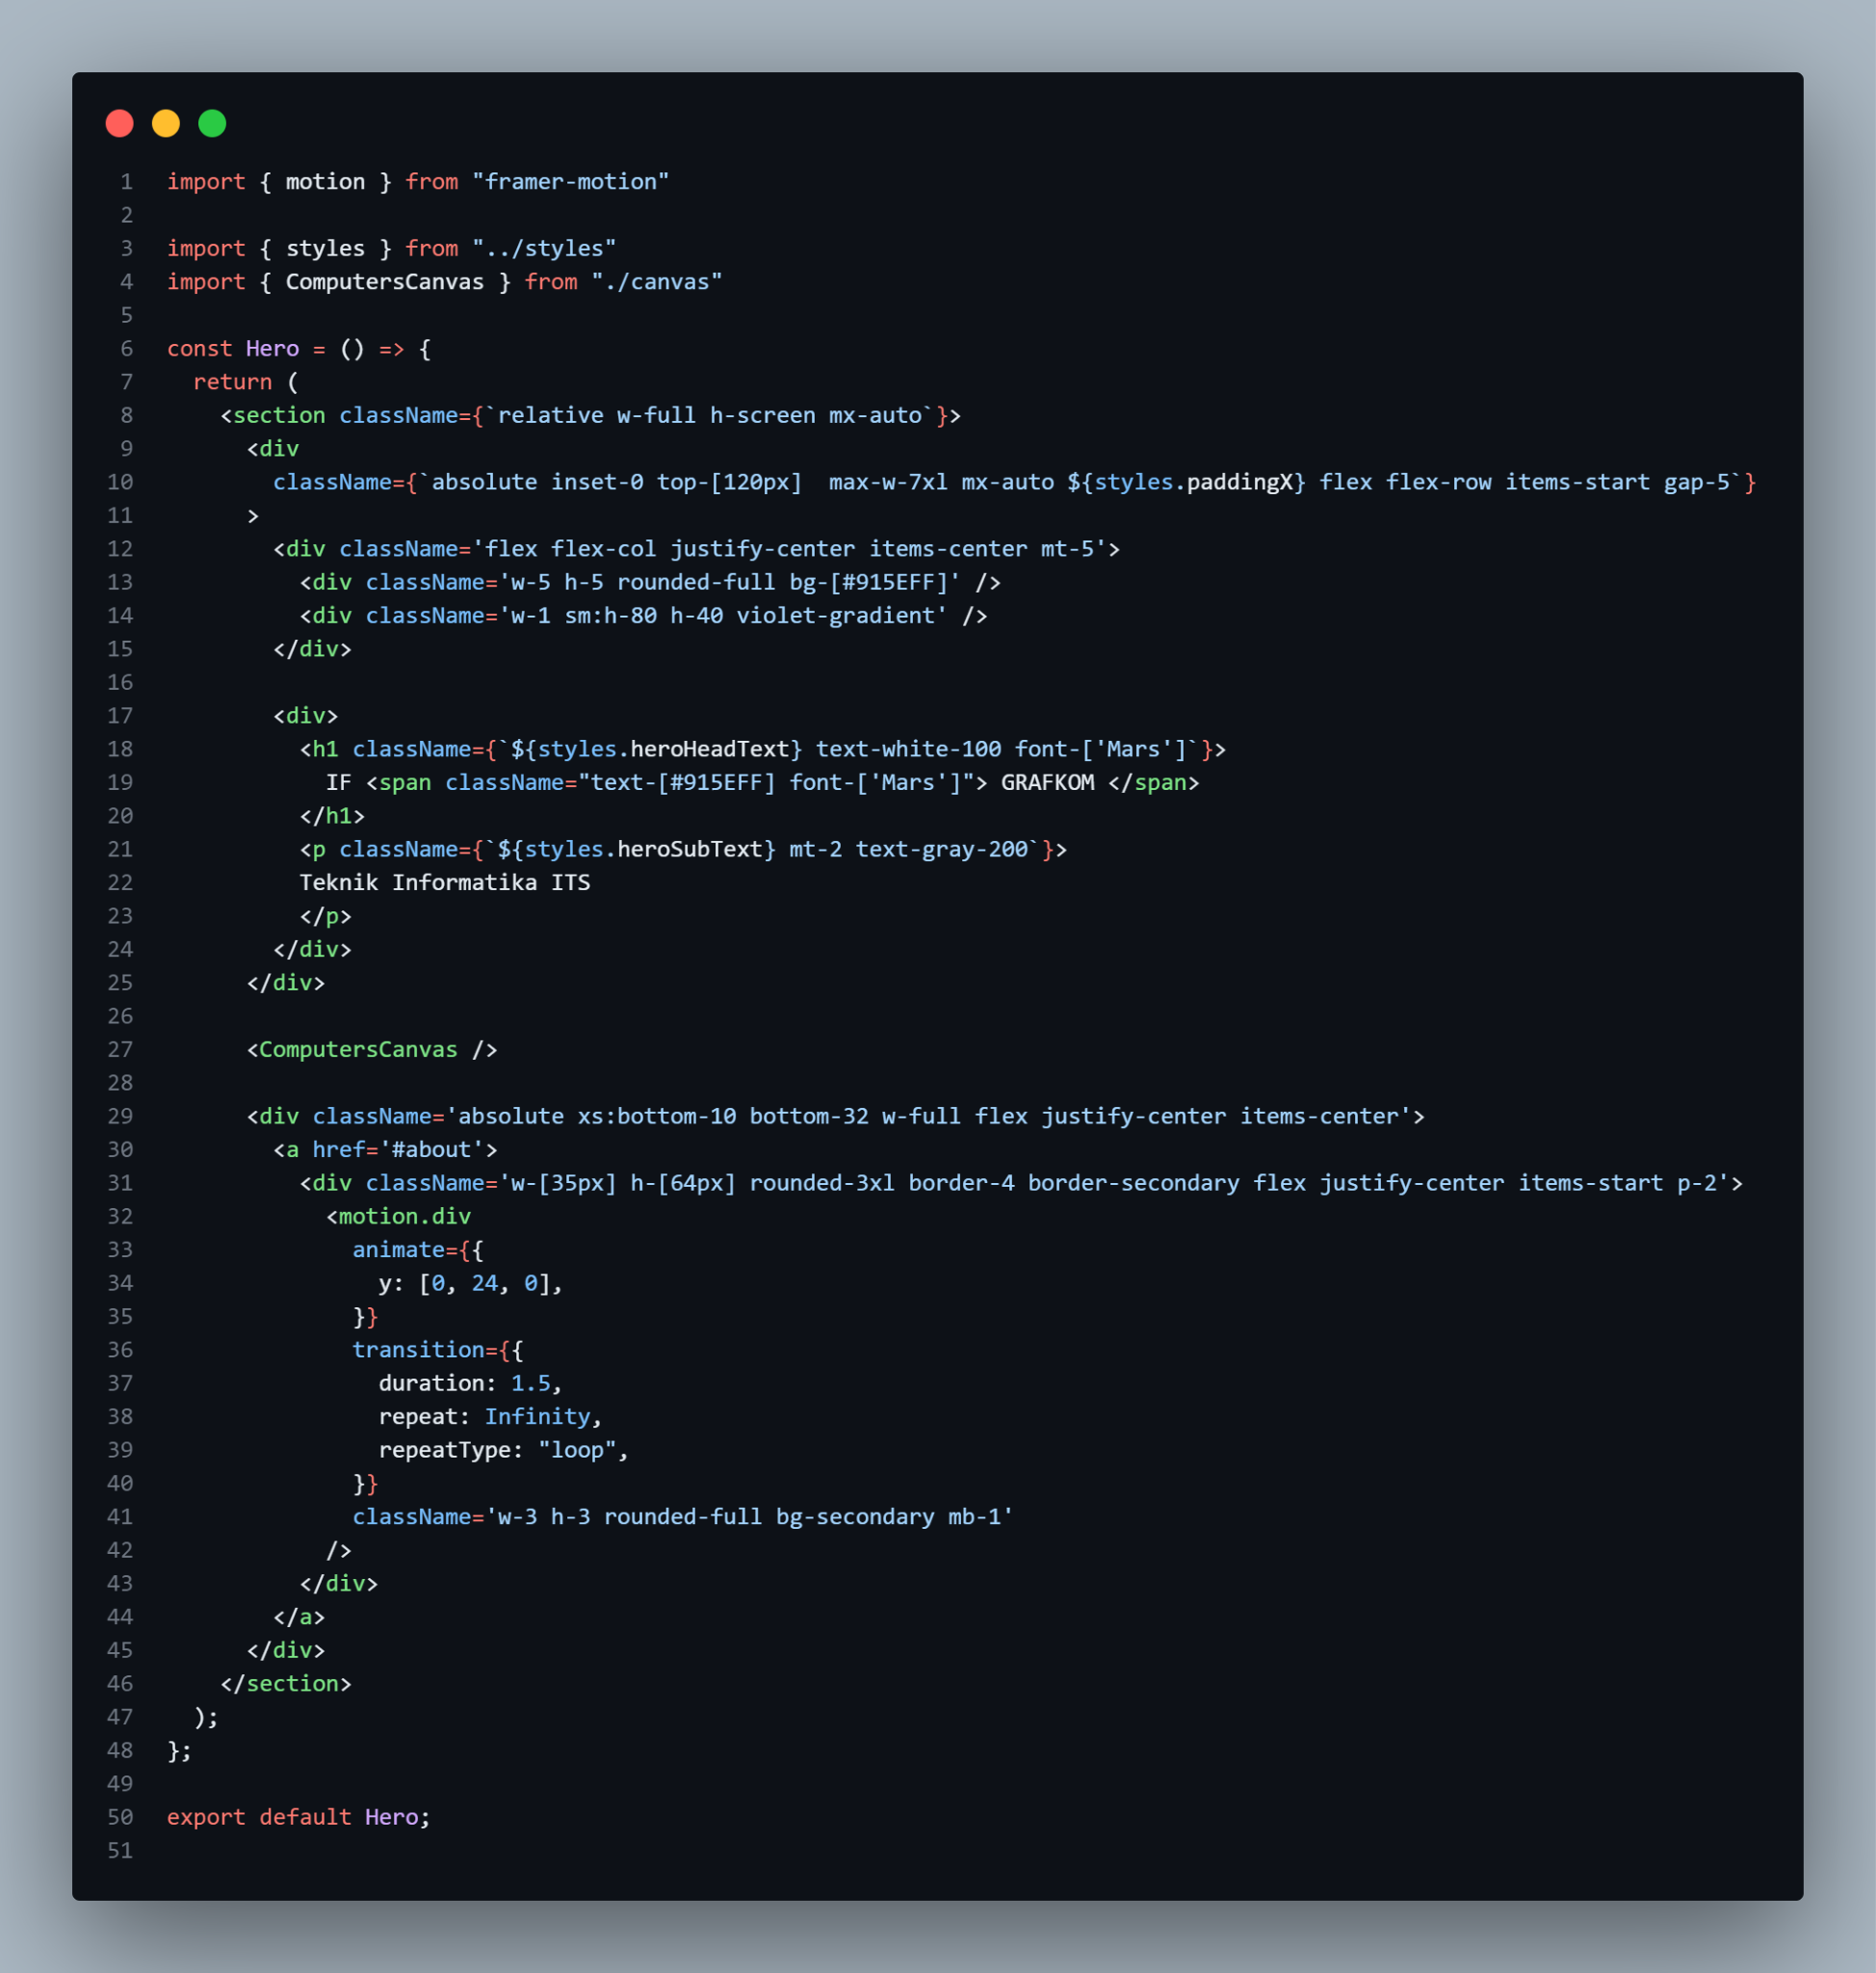
Hero.jsx
This calls the `ComputerCanvas` element. There is also another <div> element which contains an anchor tag (<a>) with a href attribute set to '#about', It has a rounded rectangular shape and contains an animated dot element (<motion.div>) using the motion object from the "framer-motion" library. The dot animates vertically with a repeating motion defined by the animate and transition properties

Slide 13
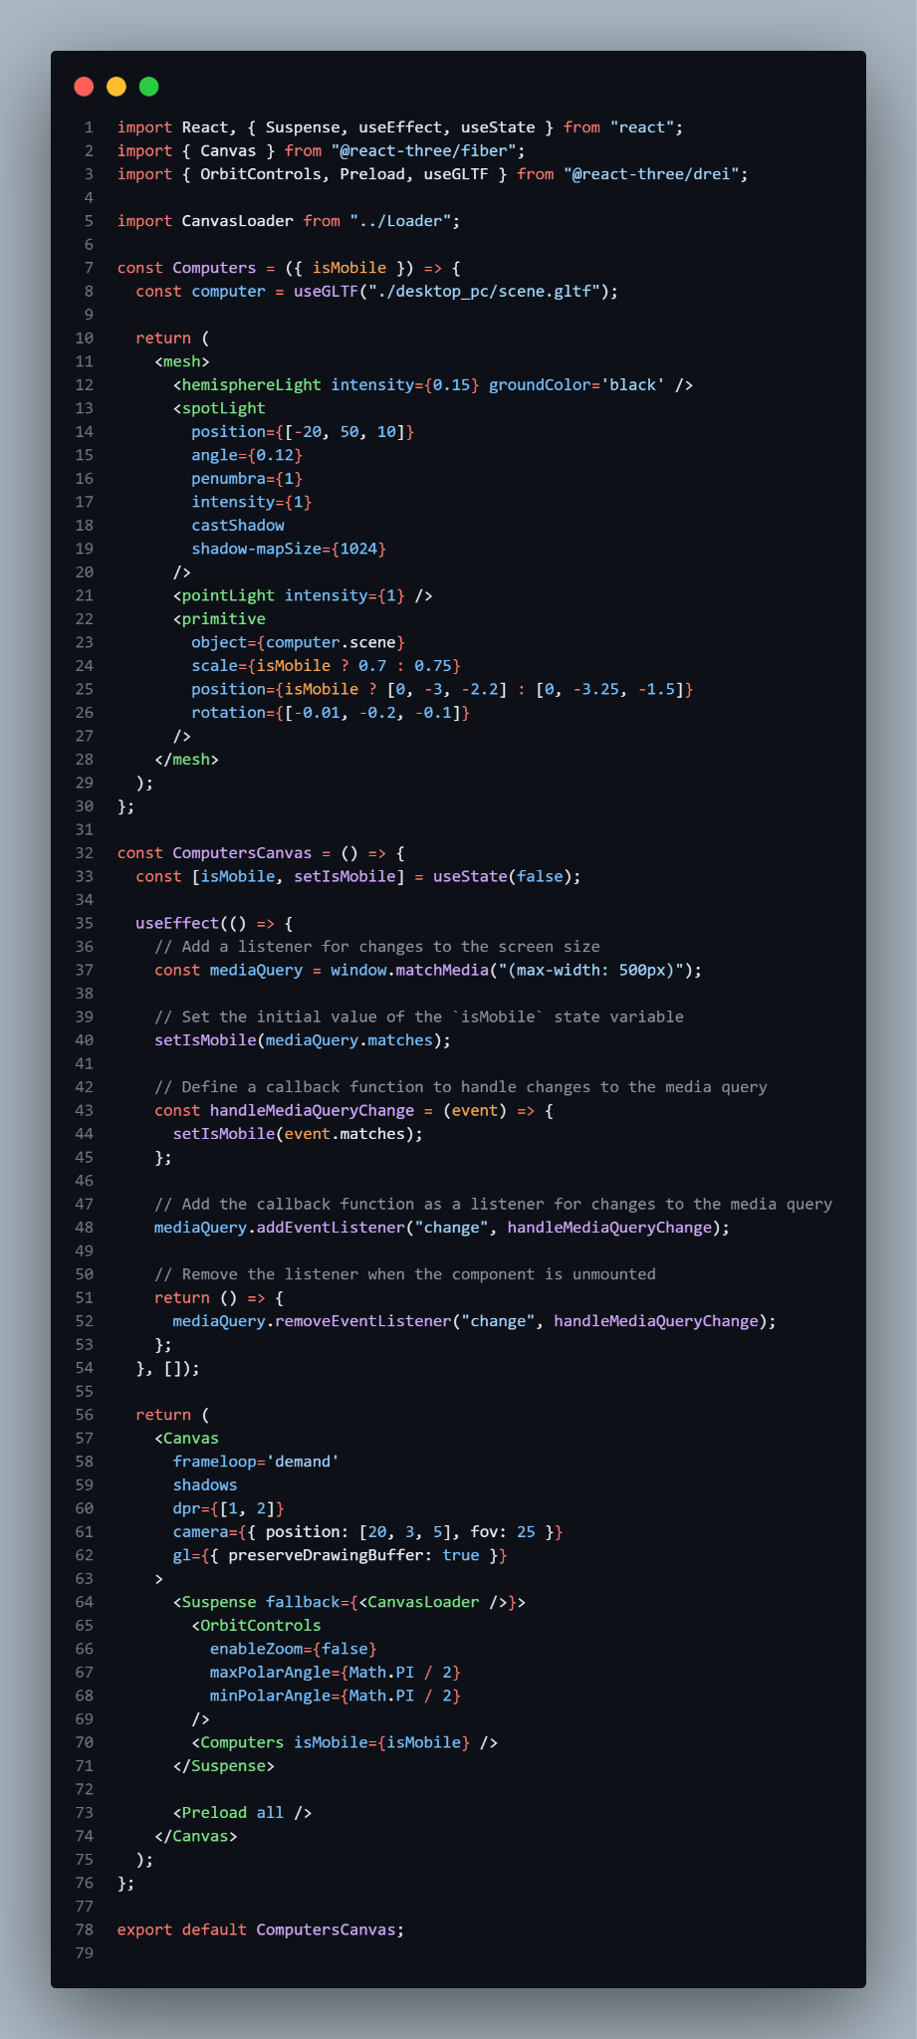
Computers.jsx pt.1
In this computer.jsx, we use the `useGLTF` hook to load the3D model of a desktop located at ./desktop_pc /scene.gltf. The loaded model is assigned to the computer variable. The component returns a <mesh> element, which serves as a container for the 3D scene. Inside the <mesh>, there are several lighting elements defined; <hemisphereLight> which represents a hemisphere light with an intensity of 0.15 and a ground color of black. It provides ambient lighting to the scene. <spotLight> which represents a spotlight positioned at [-20, 50, 10] with specific properties angle, penumbra, intensity, and shadow casting.
It provides directional and focused lighting with shadows and <pointLight> which represents a point light with an intensity of 1. It provides additional lighting to the scene. The 3D model of the computer is rendered as a <primitive> component. The object prop is set to computer.scene, which is the loaded 3D model from the `useGLTF` hook.

Slide 14
Computers.jsx pt.2
The <Canvas> element is configured with several props. `frameloop` is set to 'demand', which means the rendering loop will only occur when requested. `camera` configures the camera position and field of view. `gl` configures the WebGL renderer, with preserveDrawingBuffer set to true to allow capturing the canvas as an image.
Inside the <Canvas>, there is a <Suspense> component that provides a fallback UI (the <CanvasLoader /> component) while the content is loading.
The <Computers> component is rendered, passing the isMobile prop to control the scaling and positioning of the computer model. Finally, the <Preload> component from @react-three/drei is used to ensure all assets are preloaded before rendering the scene.

Slide 15
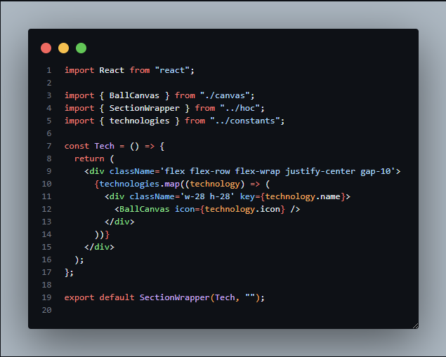
Tech.jsx
The Tech component returns a <div> that sets up a flex container that displays its children in a row, wraps them to the next line when necessary, centers them horizontally, and applies a gap of 10 units between them.
Inside <div>, there is a mapping over the technologies array using the map method. For each technology object, a <div> element with the class name 'w-28 h-28' is rendered. This sets the width and height of each container element to 28 units.
Inside each container element, the BallCanvas component is rendered. The icon prop is passed to the `BallCanvas` component, which represents the icon or image associated with the technology in the `Ball`(s).

Slide 16
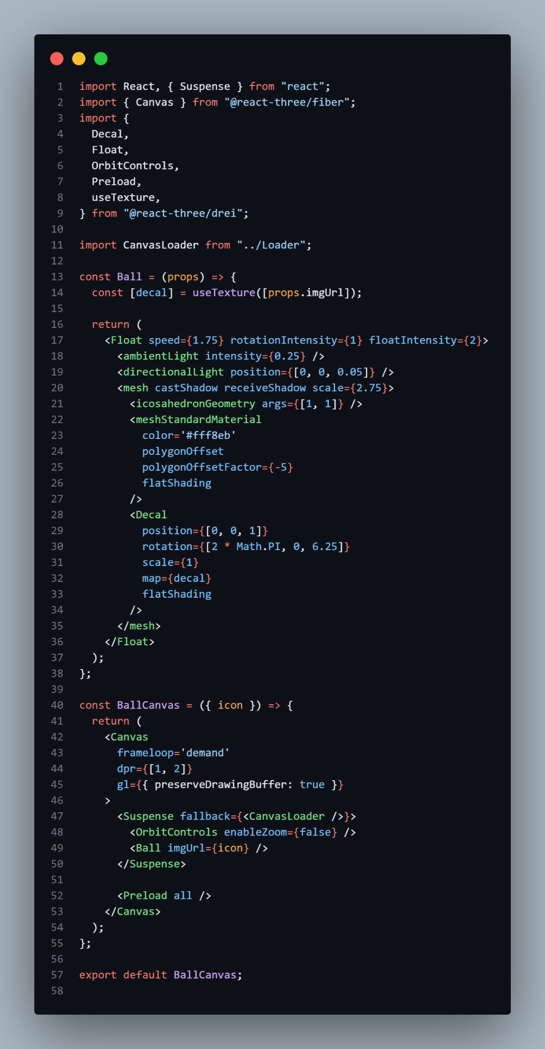
Ball.jsx pt.1
The Ball component represents a 3D ball with an image `decal` applied to its surface. It receives the imgUrl prop, which is the URL of the image.
Inside the Ball component, a <Float> component from the @react-three/drei library is used to add floating animation to the ball. It receives `speed`, `rotationIntensity`, and `floatIntensity` props to control the animation behavior.
Several lighting elements are defined within the <Float> component: <ambientLight> which provides ambient lighting with an intensity of 0.25 and <directionalLight> which represents a directional light positioned at [0, 0, 0.05].
A <mesh> component is used to render the ball geometry. It has a scale of 2.75 and casts and receives shadows. The ball geometry is created using an <icosahedronGeometry> component with radius 1 and detail 1.
The ball is rendered with a <meshStandardMaterial> component and applies polygon offset, and uses flat shading.

Slide 17
Ball.jsx pt.2
A <Decal> component is added as a child of the <mesh>. It represents the decal applied to the ball's surface. It receives props like position, rotation, scale, map of the decal texture, and `flatShading`. The BallCanvas component represents the canvas for rendering the 3D ball with the decal. It receives the icon prop, which likely represents the URL of the decal image.
Inside the BallCanvas component, a <Canvas> component from the @react-three/fiber library is used to create the WebGL canvas for rendering the 3D scene.The <Canvas> component is configured with props like frameloop set to 'demand', dpr set to [1, 2] for device pixel ratio, and gl with preserveDrawingBuffer set to true to enable capturing the canvas as an image. The <OrbitControls> component from @react-three/drei is added to enable the user to orbit around the scene.
The Ball component is rendered within the <Suspense>, passing the imgUrl prop to specify the decal image. And the <Preload> component from @react-three/drei is used to ensure all assets are preloaded before rendering the scene.

Slide 18
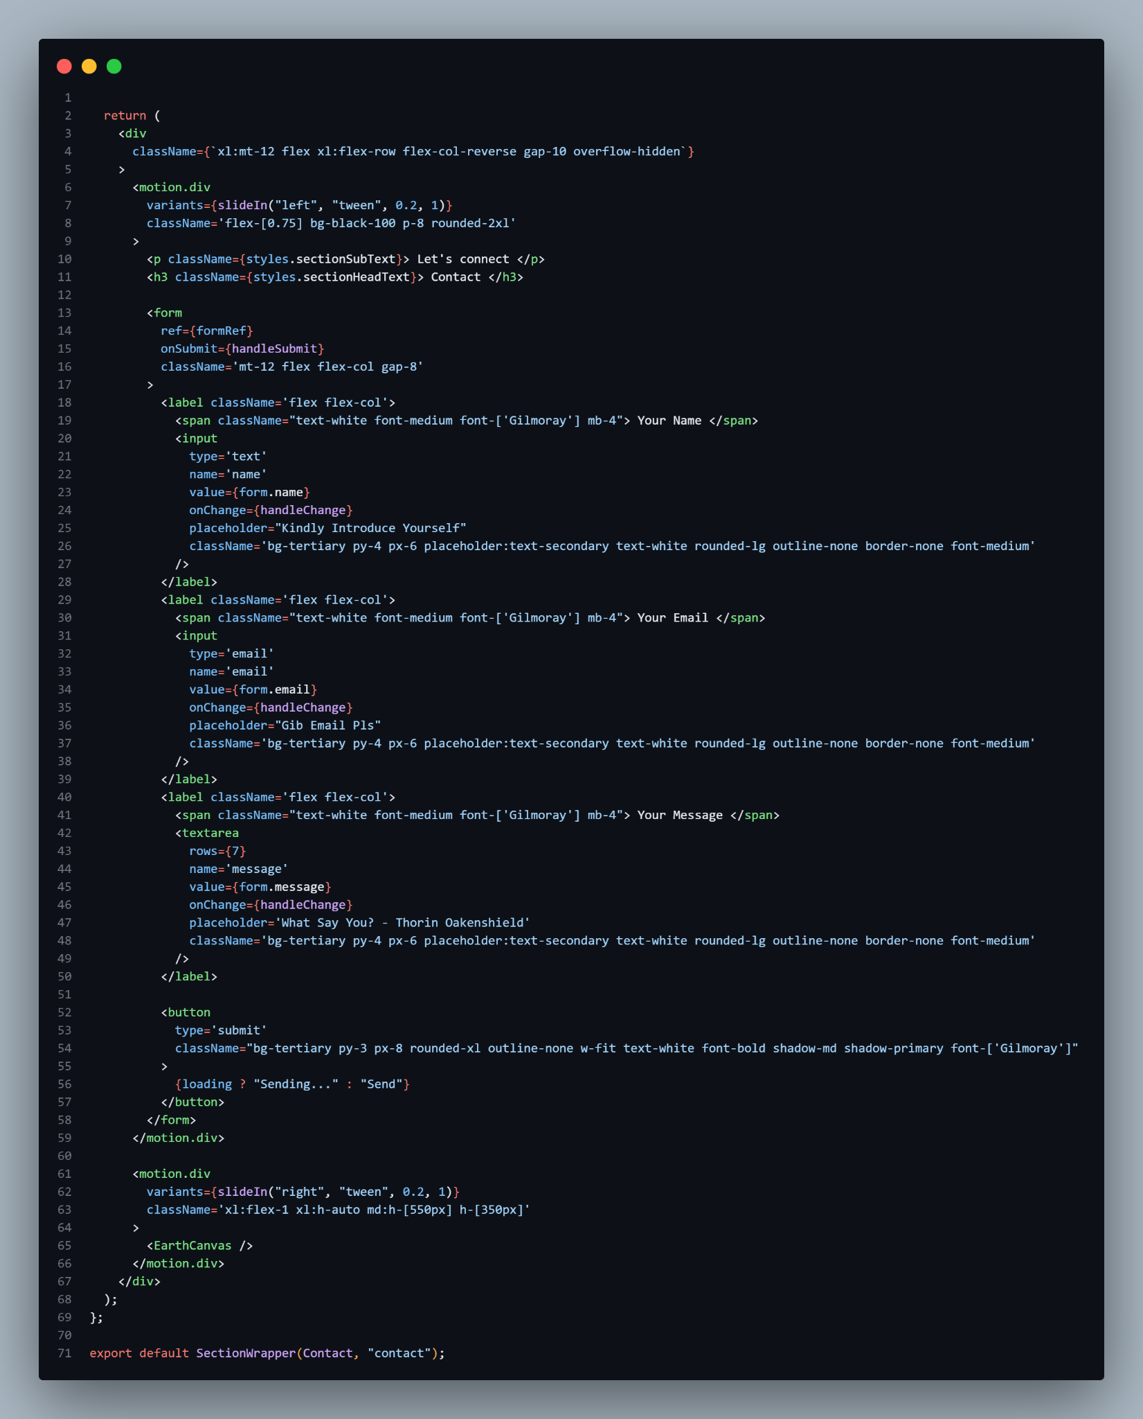
Contact.jsx
The `Contact` component combines a form for user input and an interactive visual element to create a contact section in a larger application. It calls <EarthCanvas /> which renders a rotating globe 3D element.

Slide 19
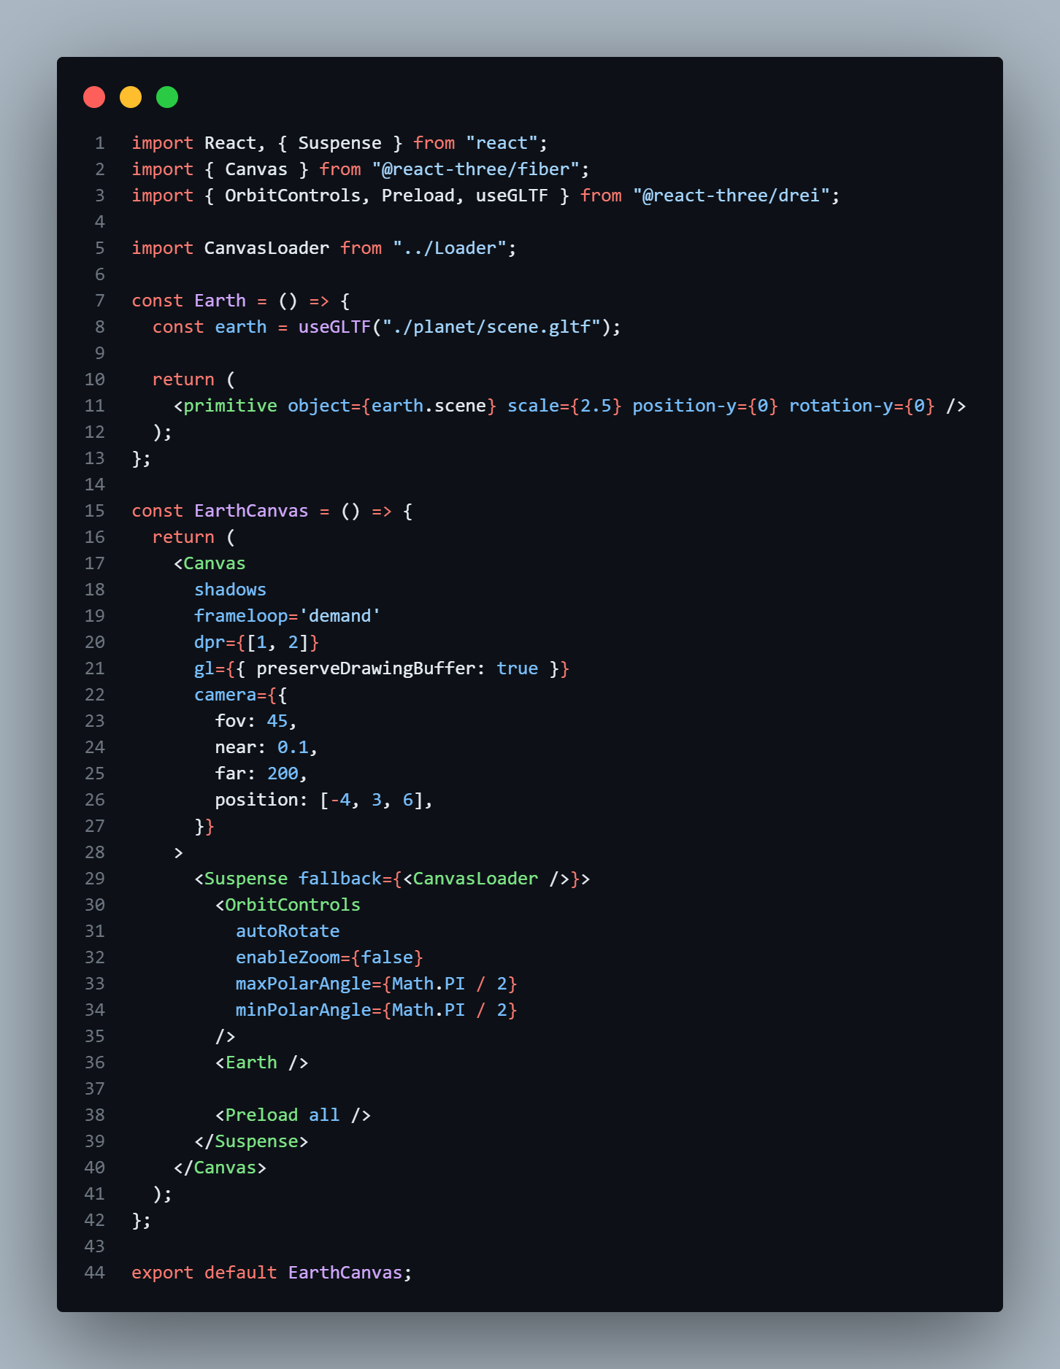
Earth.jsx
The `Earth` component uses the `useGLTF` hook from @react-three/drei to load a 3D model of the Earth from a GLTF file. The loaded Earth model is rendered as a primitive component with the object prop set to the scene property of the loaded model.
The `EarthCanvas` component is defined as a functional component. It renders a Canvas component from react-three-fiber, which provides the 3D rendering context. The Canvas component is configured with props:`shadows` enabling shadows in the scene. `frameloop='demand'` which specifies that the rendering loop should be triggered manually. `gl={{ preserveDrawingBuffer: true }}` enabling preservation of the drawing buffer for capturing the canvas content. `camera`: Configures the camera used in the scene, including the field of view, near and far clipping planes, and initial position.
The OrbitControls component from @react-three/drei is added to enable orbit controls for the camera. It allows the user to rotate the camera around the scene. The Earth component is rendered inside the Suspense component, which displays the loaded Earth model when it is ready. The Preload component from @react-three/drei is used to preload all assets, ensuring that the 3D model and any associated resources are fully loaded before rendering.

